Slide 1

To
Our Presentation
Welcome

Slide 2

Team members :
1.Israt Jahan Samia
2.Meghla monir
codeSqare
3.Fatema johor
Submitted to:Md.Nazmul Hoq Salim
Lectuer of CSE
Daffodill international university

Slide 3
Our Goals To Show :
To give a clear concept about Book shop
management system.

Slide 4
We use
Graphical User Interface (GUI)
Database (New)
Georgian Calendar

Slide 5
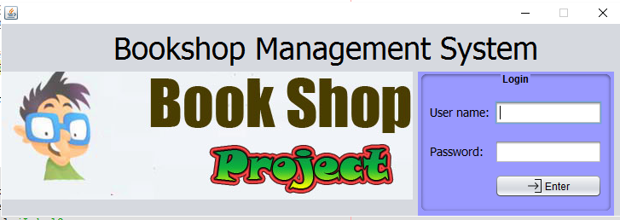
Login frame

Slide 6
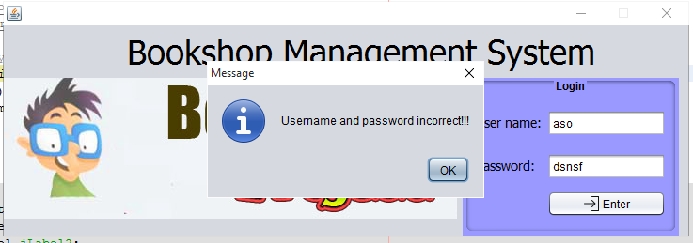
Login frame

Slide 7
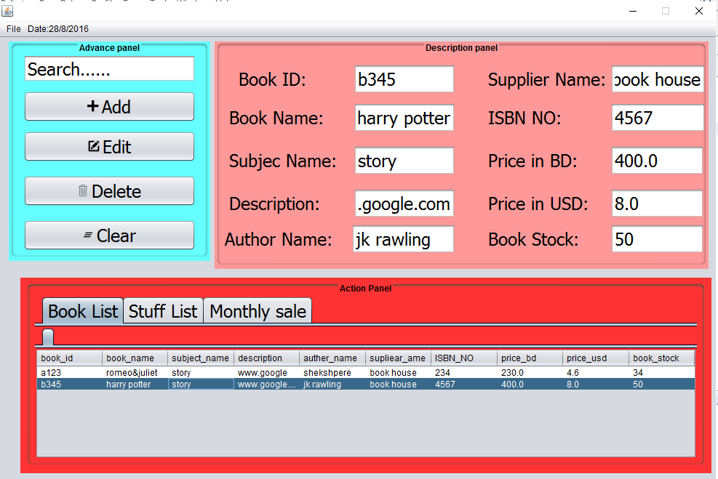
Main Frame

Slide 8
Design Of Main Frame

Slide 9
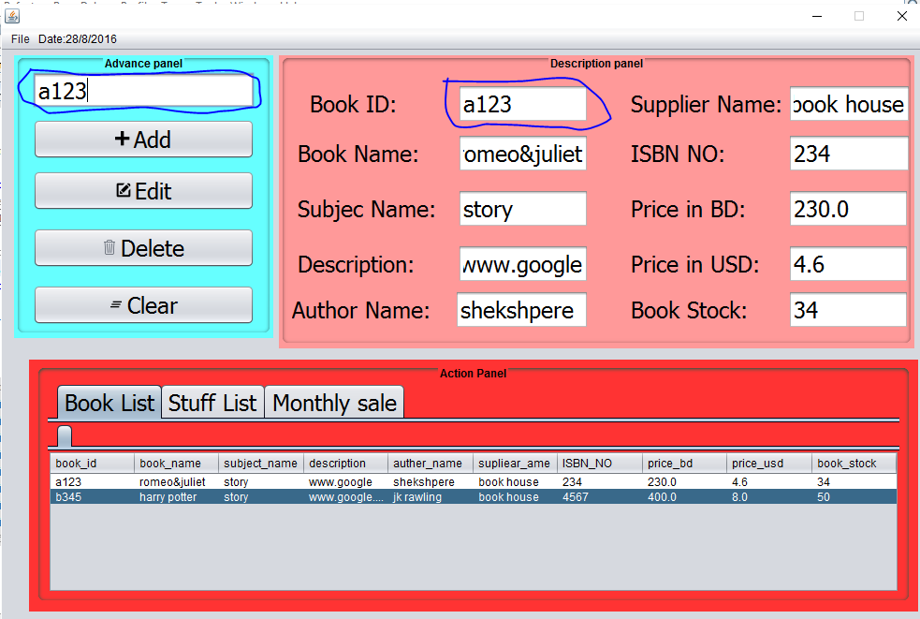
Search

Slide 10
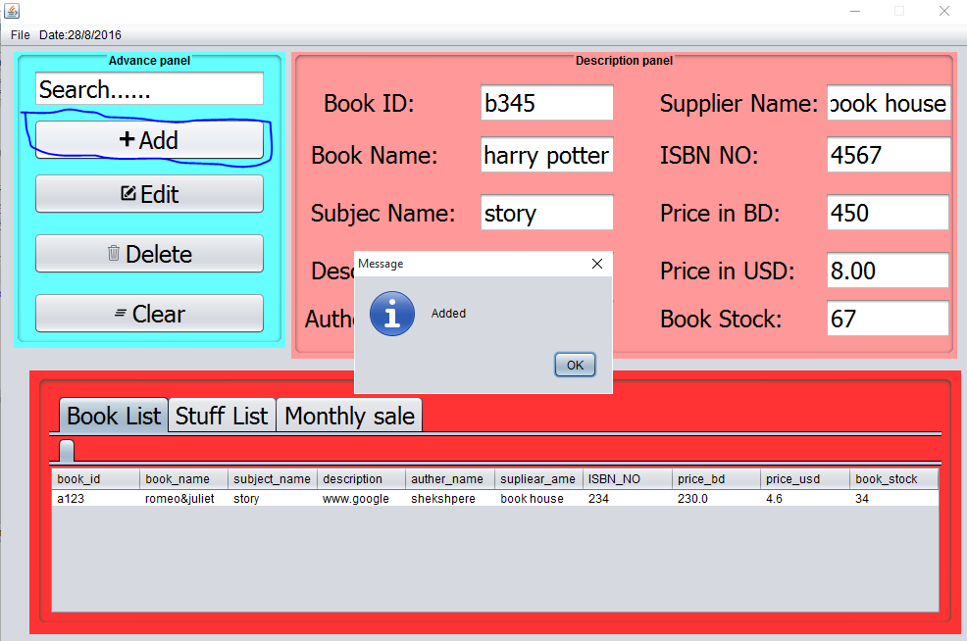
Add button

Slide 11
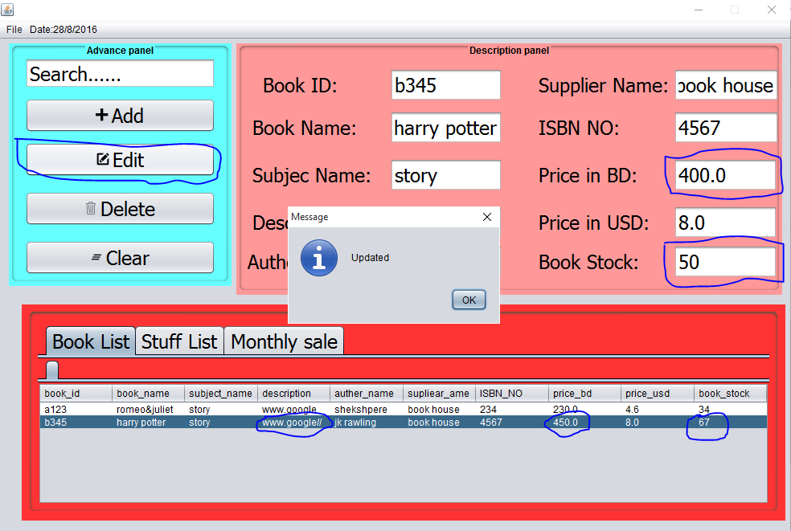
Edit Button

Slide 12
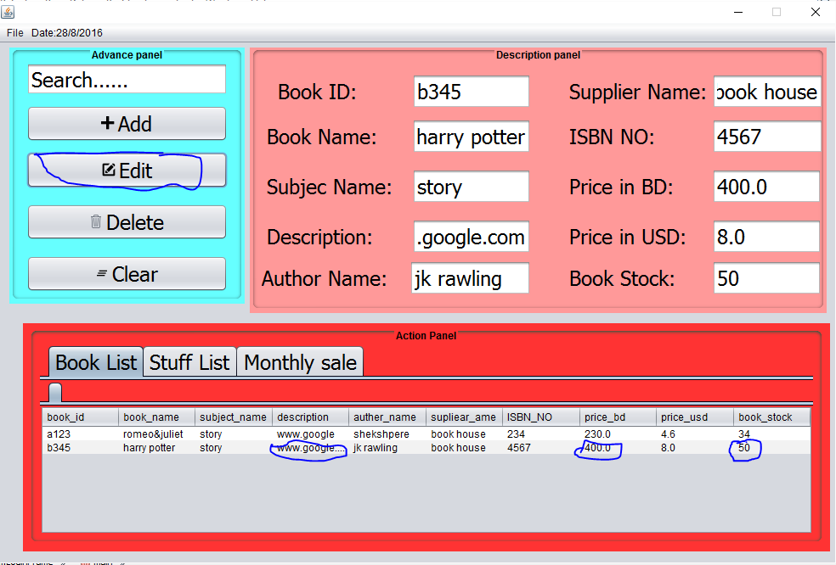
Edit Button

Slide 13
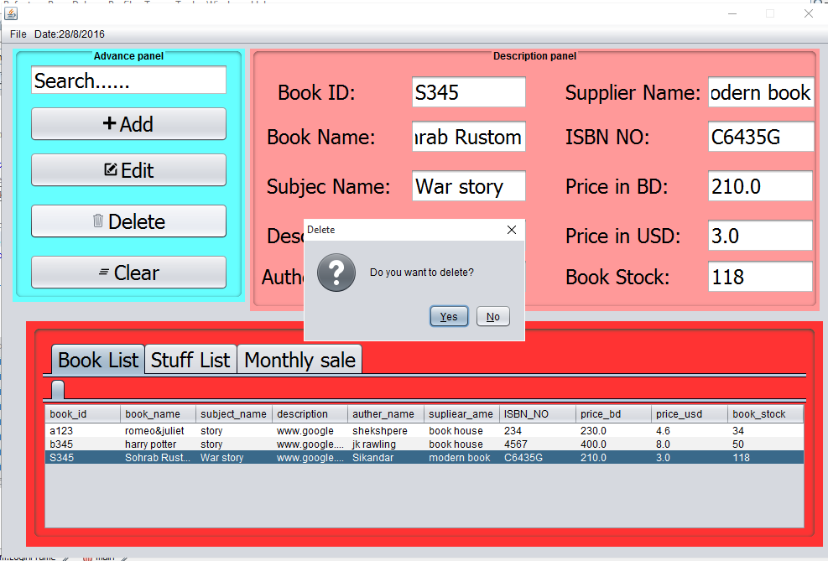
Delete Button

Slide 14
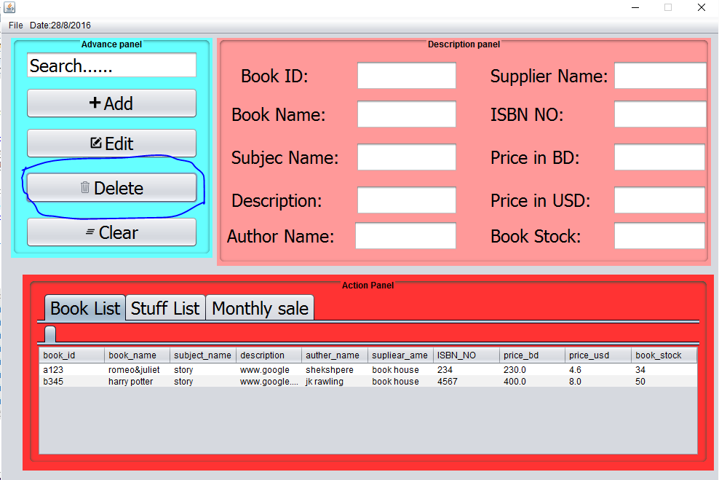
Delete Button

Slide 15
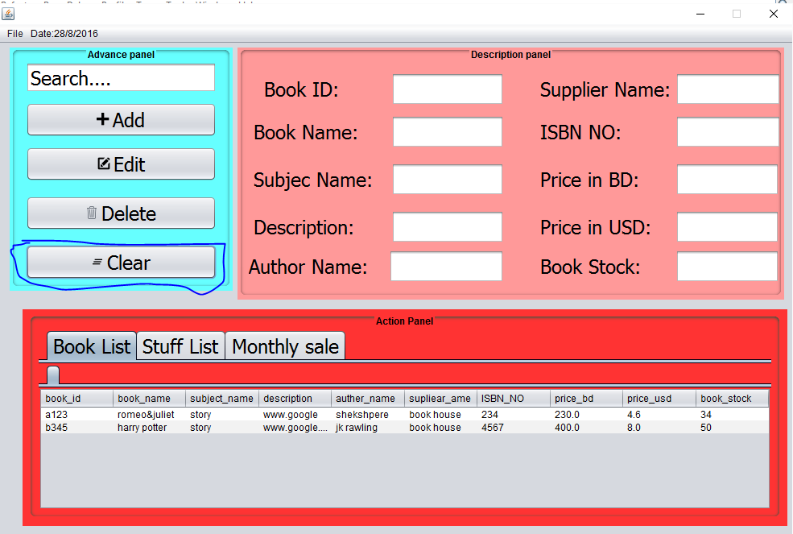
Clear

Slide 16
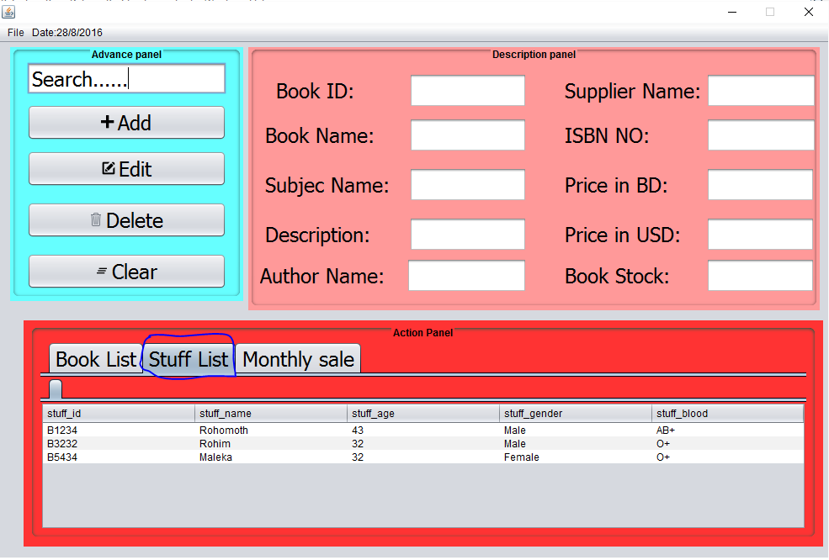
Tabbed Pane Stuff list

Slide 17
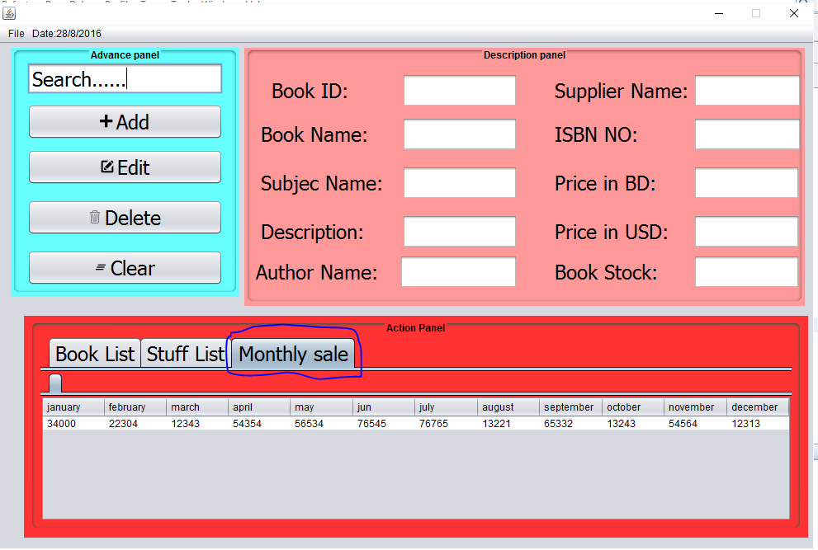
Tabbed Pane Finance

Slide 18
ALSO

Slide 19
Facing Problems
SQL Exception (Sometimes)
Database lock (Sometimes)
Editing Data mistake (Sometimes)
Does not work properly when I design mainframe

Slide 20
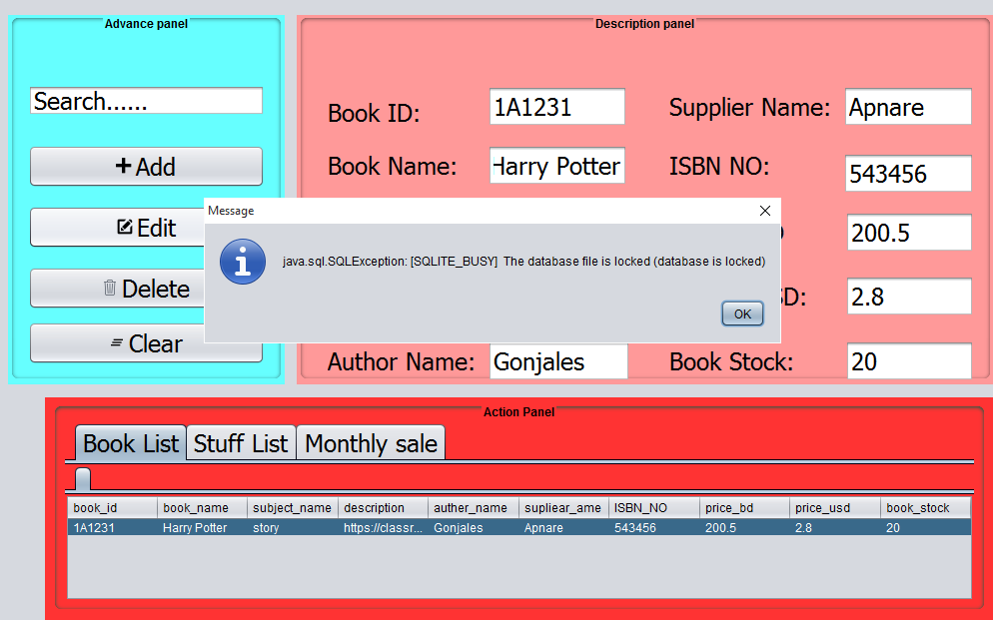
Error

Slide 21


Slide 22


